Slide 1


PreBoot Authentication Password Cracking on a budget
H2HC conference, Sao Paulo, Brasil
Jonathan Brossard, Nov 2009
endrazine@gmail.com

Slide 2
« A desobediência é uma virtude necessária à criatividade »
- Raul Seixas

Slide 3
Before we start...
Thanks to the organizers, sponsors and volonteers for making this happen in Brasil :)
Thank you for coming.
I'm very happy to be here !

Slide 4
Agenda
Introduction
Keyboard internals
Brute forcer design
Experimental results
Conclusion & bonus !

Slide 5
Goals, contributions :
Demonstrate the feasability of brute force attacks on preboot authentication passwords.
Give a pessimist estimation of the cost of password cracking on full encryption software using a generic instrumentation methodology.
Use this metric to adapt password length policy acording with the value of the protected assets.

Slide 6
Juridical environment
Cryptographic software is mostly legalized in both North and South America and Europe.
Wikipedia : « In China, a license is still required to use cryptography. Many countries have tight restrictions on the use of cryptography. Among the more restrictive are laws in Belarus, Kazakhstan, Mongolia, Pakistan, Russia, Singapore, Tunisia, and Vietnam. »
Users of cryptographic software must give either a copy of their keys or plain text equivalent of any text asked by authorities in case of trial, or face prison sentences in most countries.

Slide 7

Crypto software poor reviews
+ Governments interrests
+ global business communications
+ terrorism blah blah
= high risk of (cryptographic ?) backdoors
& privacy threats

Slide 8
Is such a thing credible?
Quoting Wikipedia :
« DES was designed to be resistant to differential cryptanalysis, a powerful and general cryptanalytic technique known to NSA and IBM, that became publicly known only when it was rediscovered in the late 1980s. According to Steven Levy, IBM rediscovered differential cryptanalysis, but kept the technique secret at NSA's request. The technique became publicly known only when Biham and Shamir re-rediscovered and announced it some years later. The entire affair illustrates the difficulty of determining what resources and knowledge an attacker might actually have. »

Slide 9
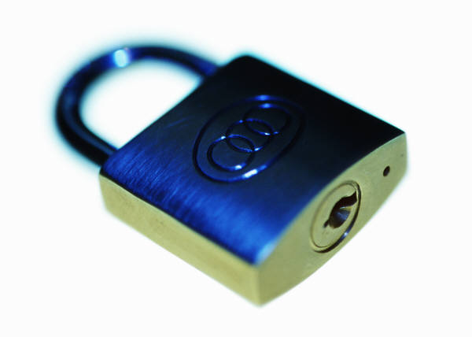
Technical motivations
Even serious developpers don't test their crypto software enough, if at all (Debian SSL bug : ~32k keys).
Vendors (in particular Truecypt) have adopted policies where they do not cover certain attacks (eg: Plain text password leakage as we presented at Defcon 0x16, or Joanna Rutowska's evilmaid attack) leaving the «official» attack surface left to : computer theft. Or simply put :
- brute force,
- brute force,
- oh, and of course, brute force !

Slide 10
More globally
Non tech people will say :
« if it fails just go for bruteforce ».
Sure.. but how do you do it ?
I couldn't find a public tool myself. And then I started to wonder...

Slide 11

Keyboard internals

Slide 12

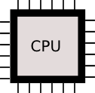
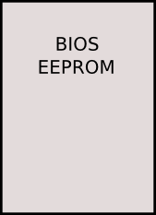


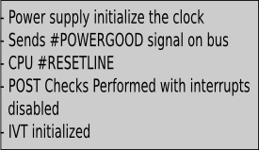
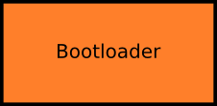



II-1) Boot sequence overview

Slide 13
II-2) BIOS API for user inputs (1/2)
  Interruption 0x16 invoked via functions :
  ah=0x00 , “Get keystroke” : returns the keystroke scancode in AH and its ASCII code in AL.
  ah=0x01 , “Check for keystroke” : idem, but the Zero Flag is set if no keystroke is available in the Bios keyboard buffer.

Slide 14
II-2) BIOS API for user inputs (2/2)
  eg : lilo password reading routine :

Slide 15







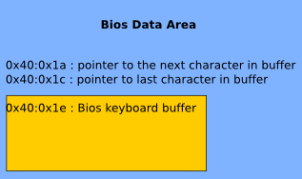






II-3) BIOS internals for keyboard management

Slide 16
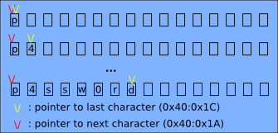
II-4) BIOS keyboard buffer Remanance... (1/3)
Filling the BIOS keyboard buffer (with the keyboard) :

Slide 17
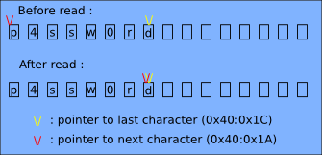
II-4) BIOS keyboard buffer Remanence...
Reading the BIOS keyboard buffer (using int 0x16, ah=0x00 or 0x01) :

Slide 18
Demo
Simulating keystrokes by PIC programming
(from real mode)

Slide 19
Demo
Simulating keystrokes by PIC programming
(from protected mode under x86 GNU/Linux)
(aka: brute force any GUI)

Slide 20
Exemple of application :
Rebooting a computer protected with a password (assuming you know that password - for now ;), by simulating keystrokes at boot time...

Slide 21



Attack scenario :
I/O Port
0x64
I/O Port
0x60

Slide 22
Notes :
- You can get the code for this attack from the Defcon archive (the attack is called « Invisible Man »).
- For our cracking purpose, writing directly to 0x41e is way more efficient (but that was cool, right ? ;)

Slide 23
Demo
Retreiving passwords from physical memory from userland without privileges
(up to Vista SP0)

Slide 24
Notes
Bitlocker's fix in Vista SP1 (replacing any character by ' ') still leaks the password length.
This plain text password leakage vulneability is still present on many software including Lilo and Grub if you can read from arbitrary physical memory locations (typically needs root privileges).

Slide 25
Brute forcer design

Slide 26
Challenges
Installation & initial control flow modification (BIOS Firmware, other media, MBR replacing/patching)
Maintaining control (BP, IVT hijack, runtime patching)

Slide 27
Design decisions
We want something as generic as possible, so we will avoid application specific breakpoints etc.
The media we boot from is irrelevant (usb/cdrom/floopy..)
Keeping control over the control flow is a bit tricky.
Very similar to MBR virus writting (old school !! ;)

Slide 28
Interrupts hijacking
Int 0x13 : we need to proxy calls to the original int 0x13, changing disk number (dl). It also allows to detect successfull decryption
Int 0x16 : simulate keystrokes
Int 0x10 : for performance (we don't need display)

Slide 29
Full attack scenario
Boot from our code (1 sector)
Allocate BIOS memory
Copy the rest of our code there
Patch the IVT (int 0x16, int 0x10, 0x13)
Emulate int 0x19 (copy code from original MBR to 0x00:0x7c00, jump there)

Slide 30
jonathan@blackbox:~/h2hc$ cat BF-OS.asm |grep -v "^;"|grep [a-Z0-9]|wc -l
902 jonathan@blackbox:~/h2hc$

Slide 31
Demo
Bruteforcing Lilo

Slide 32
Demo
Bruteforcing Grub with MD5 hash

Slide 33
Demo
Bruteforcing full disk encryption with TrueCrypt 6.3

Slide 34
Experimental results

Slide 35
Result #1
It's doable :)

Slide 36
Result #2
The cost of hashing algorithms (MD5..) is negligible in the cracking process

Slide 37
Result #3 : performance
Hashing algorithms : we tried 705 passwords in 30s.
Truecrypt : 10s / password (whow !)

Slide 38
Metrics
(assuming a hashing algo is used)

Slide 39

Time taken to crack
Irrelevant
(cloud computing !)

Slide 40
Search space
S = sigma (i=1,length) sizeof(charset)^i

Slide 41
Cost
C = O (S * 3/70 * cpu_freq/(1.6GHz) * cost_per_hour)

Slide 42
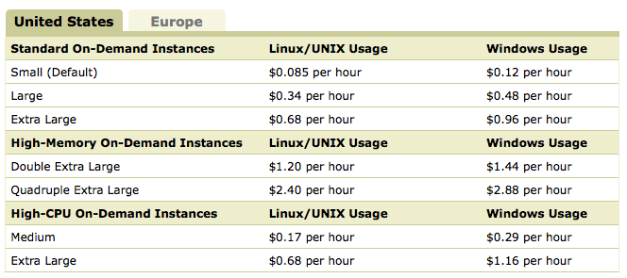
Amazon EC2

Slide 43
Cost
C ~ 3/70 * 0.085 * sigma (i=1,length)(sizeof(charset)^length)

Slide 44
Cost
Exemple :
charset = [a-z]
Pass length = 5
Cost ~ $45 000

Slide 45
Cost
Exemple :
charset = [a-z]
Pass length = 8
Cost ~ $800 000 000

Slide 46
Cost
Exemple :
charset = [a-zA-Z0-9]
Pass length = 8
Cost ~ $800 000 000 000

Slide 47
Conclusions (1/2)
- Bruteforcing is physically doable for both hashing algorithms and complex symetric systems.
- Bruteforcing remains unpractical against Truecrypt so far (6 passwords / minute, recommended pass phrases of length 20).
- This methodology, while generic, is too costly to be practical against strong passwords (unless you're .gov ?).

Slide 48
Conclusions (2/2)
- Not using TPM like technologies allows attackers to take advantage of distributed computing, making the brute force time irrelevant.

Slide 49
Bonus
Random ideas dump that could not fit anywhere else in the presentation...

Slide 50
Having Alan Cox code your i386 real mode backdoor
(if you can't afford a trainee...)

Slide 51
Faxineira.asm
Joanna Rutowska's Evilmaid attack made generic
(trojan & sniff any software's password)

Slide 52
Faxineira.asm
EvilMaid made generic
Allocate BIOS memory.
Copy yourself (1 sector) there, jump there.
Hijack int 0x10 : save any pressed key to a 16 bytes buffer, then jump to old handler.
Copy old MBR at 0x00:0x7c00
Jump to 0x00:0x7c00

Slide 53
Bootkit/Rootkit :
MBR ? floppy ? usb drive ? Cdrom ?

Slide 54
Network connections from bootloaders
(without coding your own network stack)

Slide 55
Other possible attacks
Timing attacks (count ticks using rdtsc)
Glitching (won't work :-( )
Getting physical :
FPGA (for hashing algos only : nsa@home project)

Slide 56
A few more things on TrueCrypt 6.3

Slide 57
Truecrypt's policy and assumed attack surface
No TPM support. Won't happen.
No support against root or physical attacks (bootkits, trojaning ...)
Regarding full disk encryption (the real thing why TC is great) : no keyfiles support as of version 6.3.

Slide 58
No TPM means
No hardware sealing.
We can modify the bootloader.
We can scale on hardware/virtualisation.

Slide 59
Key/pass repudiation
Setting a new key/passphrase pair is not enough : one needs to fully decrypt the drive, and then fully re encrypt it.
Old key/pass pair would still be valid otherwise.

Slide 60
Forensics : HD dump vs.
Rescue iso image
They contain exactly the same crypto information (salt+keys : only password is missing).
We can very well brute force from a Rescue cdrom image (easier to clone/steal than a whole HD).
This is not intuitive : social engineering risk increased.

Slide 61
Demo
Reversing the
Truecrypt Rescue disk

Slide 62
Valeu pela presenca ;)

Slide 63
Questions ?

